Slide 1
Flood Response Boat System
Available from

Slide 2
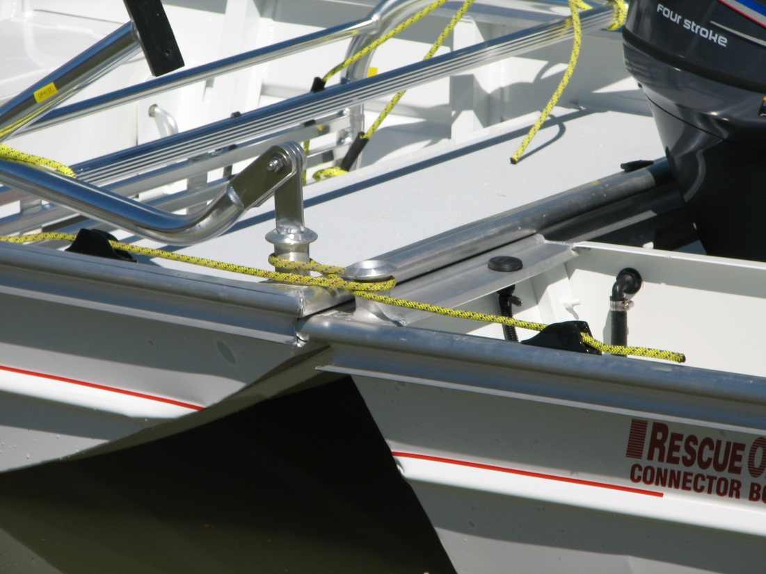
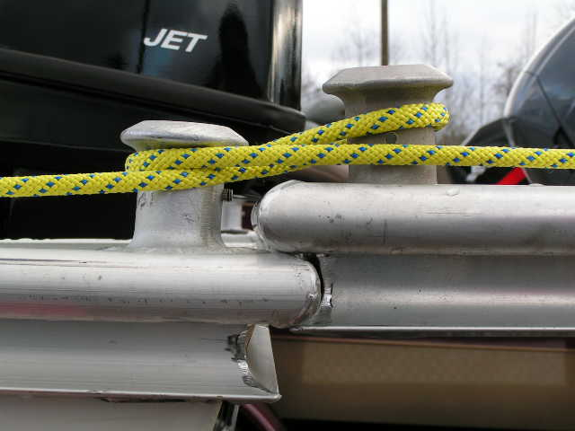
A System … Not Just a Boat
Patented QuickFIT Railing System
Unlimited Boats to Connect Together
Bow to Stern Example

Slide 3
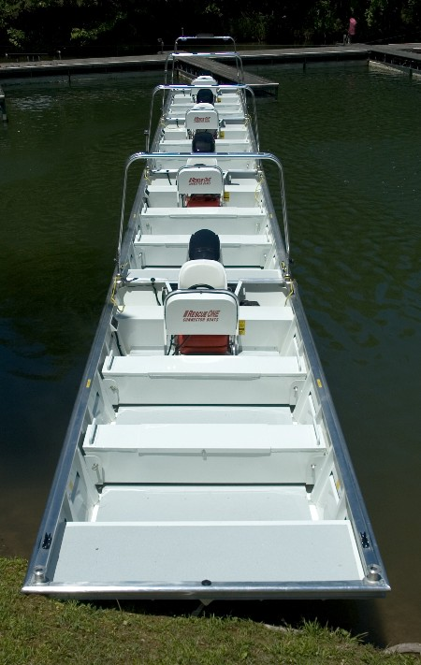
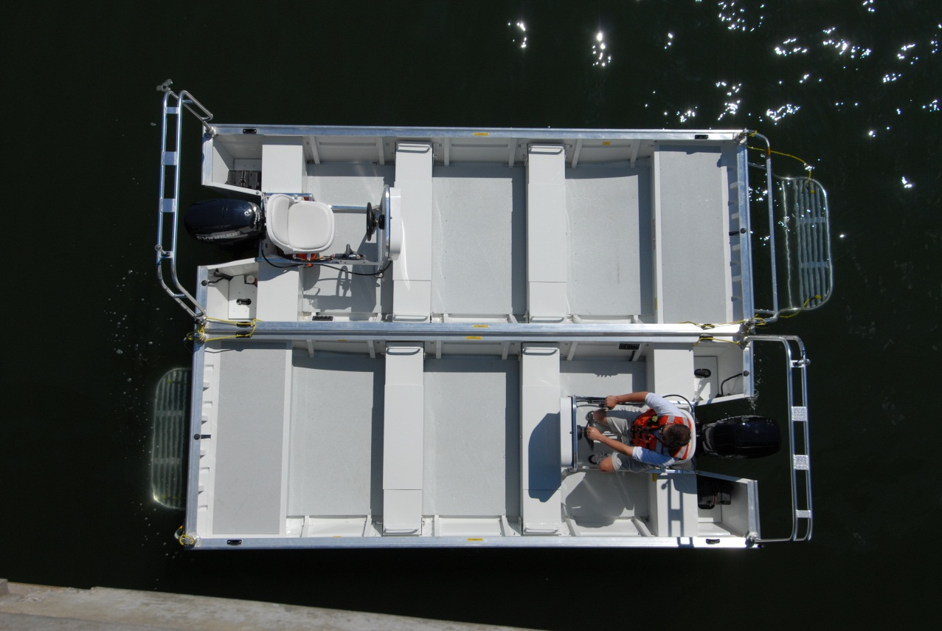
Create What You Need
Command Platform or Evacuation Bridge

Slide 4
Create What You Need
Barge to Transport Humanitarian Aid
Or Evacuate Many Victims Rather Than 2-3

Slide 5
Versatile & Cost Effective
Connected Boats provide a stable search and rescue platform
Connected Boats provide a stable platform for casualties
Connected Boats provide a stable working platform e.g. USAR operations
No Need to Buy Different Size Boats
Larger Boats Are Expensive
Provide stable search platforms for using e.g. TICs, HD Sonar etc.
Connector Boats Transform Into Larger Sizes e.g. rescue “bridges”

Slide 6
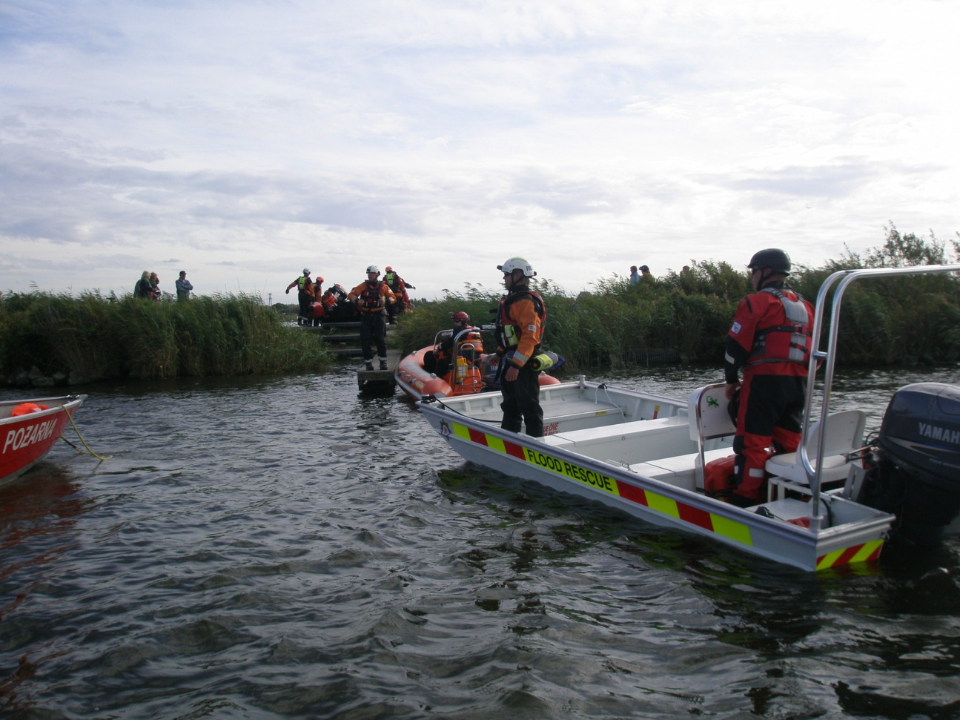
Versatile & Cost Effective
Connector Boats provide a stable search and rescue platform:

Slide 7
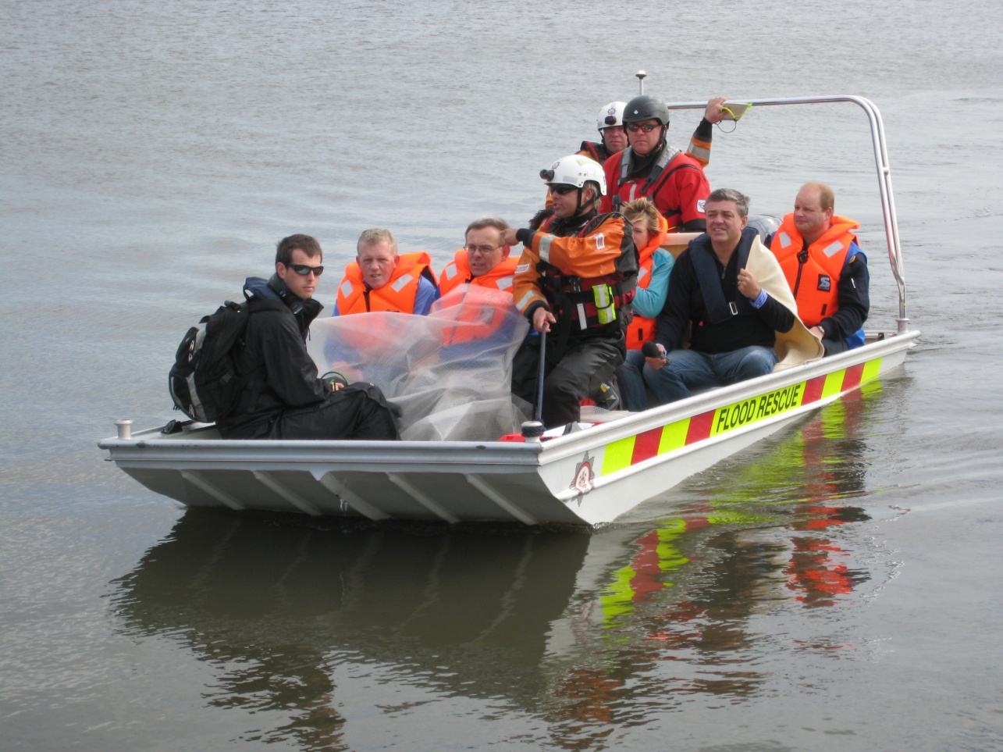
Versatile & Cost Effective
Connector Boats provide a stable platform for casualties:

Slide 8
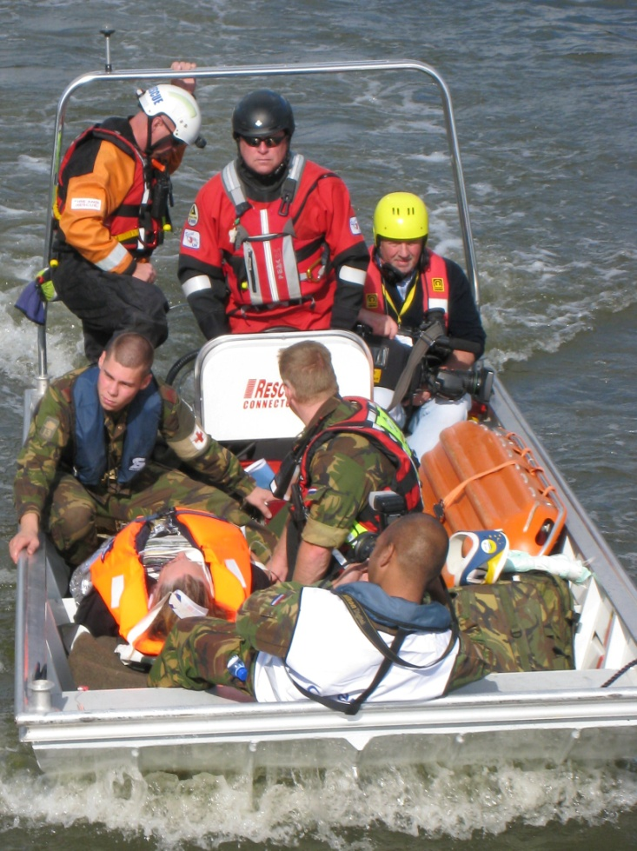
Versatile & Cost Effective
Connector Boats provide a stable working platform e.g. USAR operations:

Slide 9
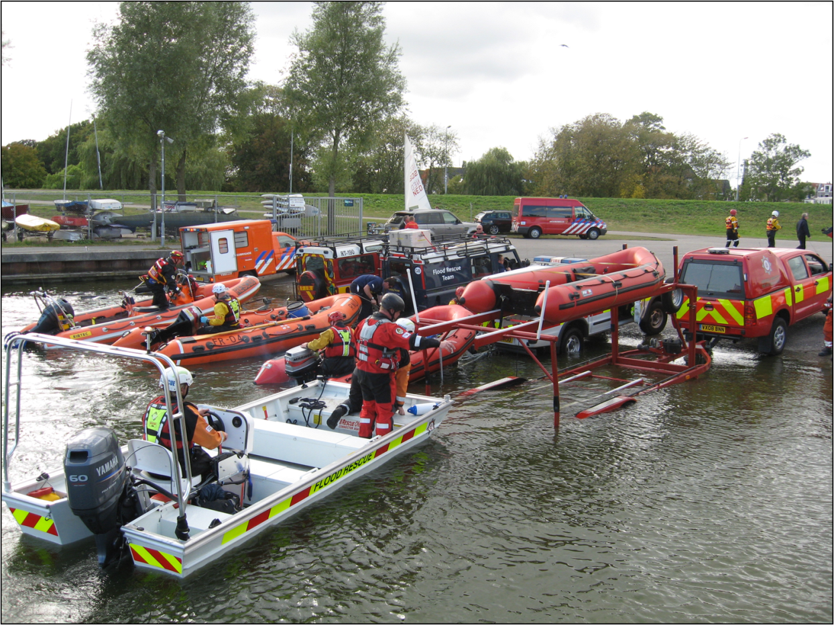
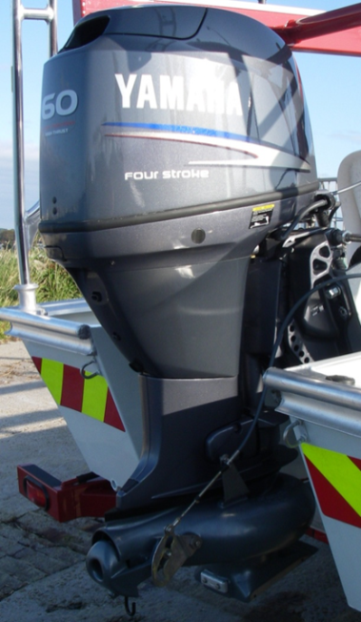
Versatile & Cost Effective
Connector Boats provide shallow draft working peerlessly with a jet drive:

Slide 10
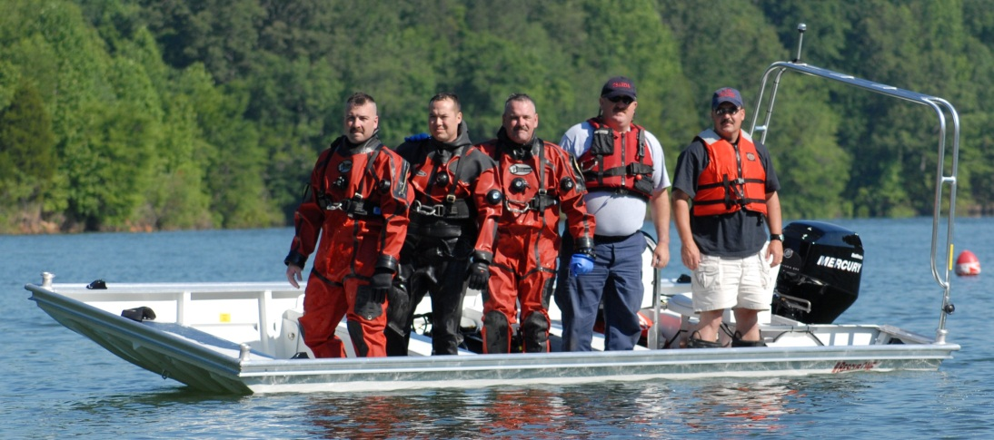
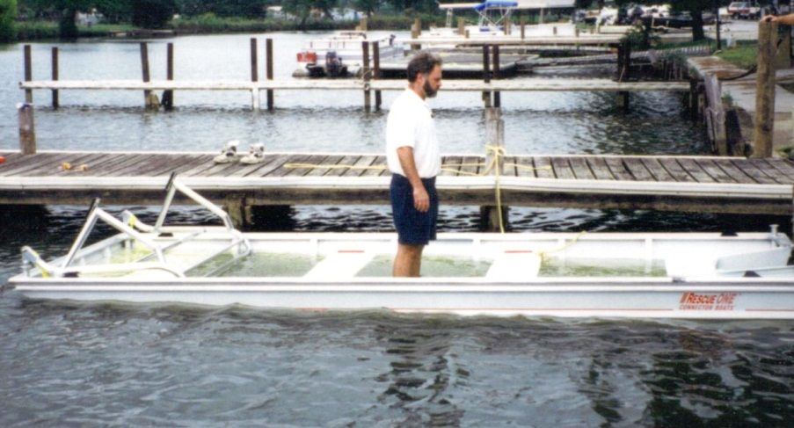
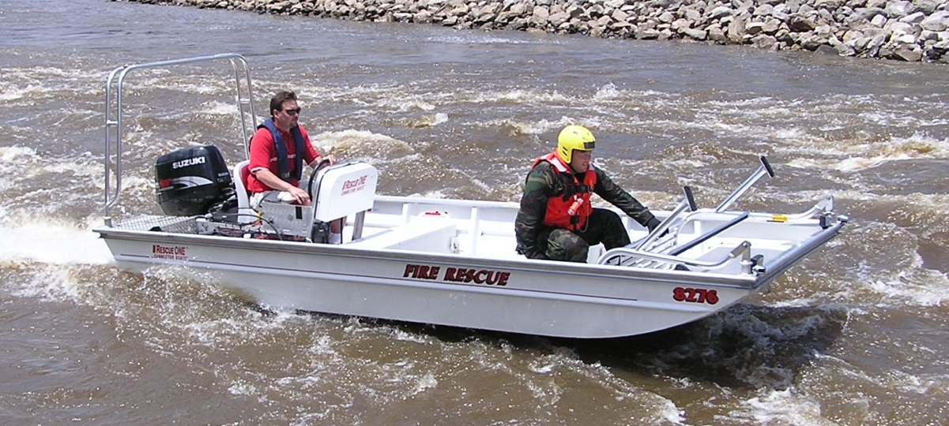
Safety Features
Extremely Stable
Unsinkable
Extremely Shallow Draft

Slide 11
Accessories – Rescue Platform

Slide 12
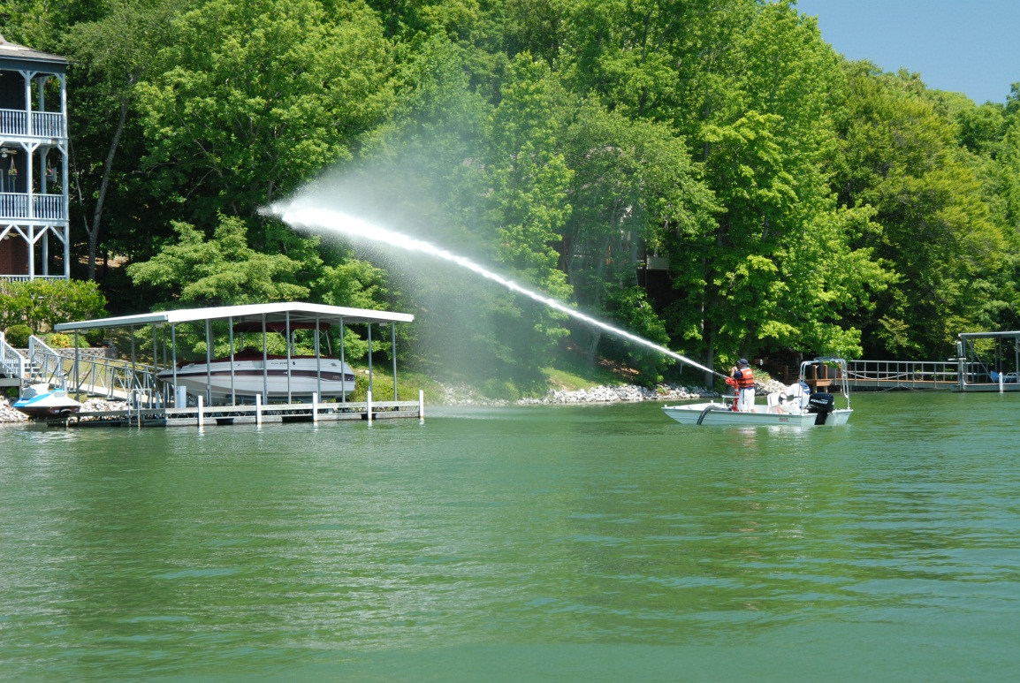
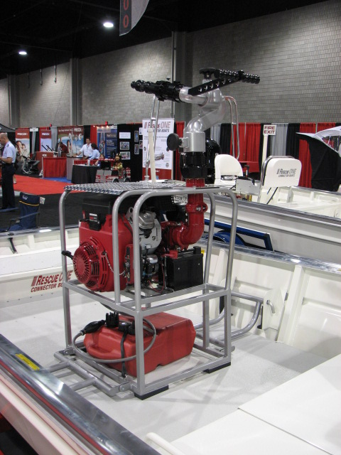
Accessories – Fire Pump

Slide 13
Technical Specifications
Boat Dimensions US Metric
Length 16’3” 4.87 m
Beam 6’ 3” 1.87 m
Draft 4” 10 cm
Side Depth-Outside 21” 53 cm
Interior Operating Room 62ft² 5.76 m²
Dry Weight 475 lbs 215 kg
Max Rated Capacity (6 persons) 1125 lbs 510 kg
Max Horsepower 50hp
Hull Material 5052 marine aluminum

Slide 14
David Lane, CEO
Professional Rescue
T +44 (0) 1202 731566
M +44 (0)7710 229082
enquiries@professional-rescue.co.uk
www.professional-rescue.co.uk

